Slide 1
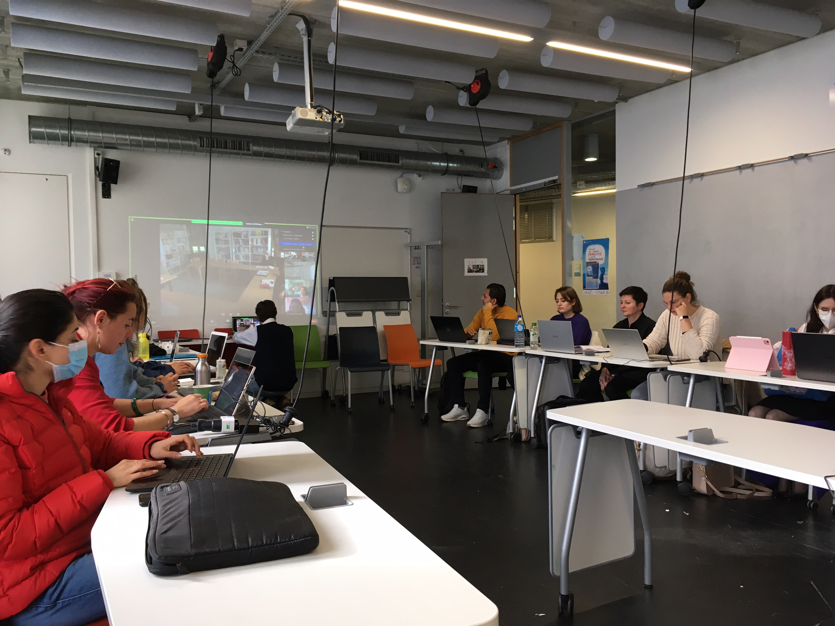
Hyflex teaching guidelines
What’s Hyflex?
Hyflex teaching accommodates both in-person and remote learners simultaneously. It enables students who are physically present in the classroom to learn alongside those who are joining the class virtually through webconferencing software or platforms.
This document offers some advice for Hyflex teaching in higher education to design space, technology and interactions in order to improve the quality of your hyflex course.
When is Hyflex helpful?
When a part of the group cannot attend class in person, to increase accessibility, to increase internationalisation, for classroom exchanges, to split a large group of students ...
Possible pedagogical settings in Hyflex
Frontal/transmissive teaching with 1 teacher and 2 groups (1 at distance and 1 in person): this setting is appropriate for lectures
Small groups with 1 or 2 students in the classroom and 1 or 2 students online: this setting is appropriate for collaborative activities.
Whole group activity (2+ teachers and 2+ classes): teachers can be in person or at a distance, learners are active and everybody participates in the joint activity.

Slide 2
A good connection (ethernet or wifi) and an optimised bandwidth (settings 1 2 and 3)
Classroom projectors to make online people visible in the classroom (settings 1 and 3)
2 cameras in the classroom to make everyone visible for online people (settings 1 and 3)
or
A sound sensitive with 360 rotation Webcam, with automatic focus on the participant speaking
Everyone needs to see everyone, as in a regular classroom
Classroom speakers to hear in the classroom what is said online + microphones in the classroom for everyone to be heard online (settings 1 and 3)
or
A multidirectional microphone
Everyone needs to hear everyone, as in a regular classroom
Many power outlets (setting 2)
Adopt a “bring your own device” approach for the students to avoid losing time for students’ technical training (setting 2)
Ask a student in the classroom to connect online to check if online students can hear and see well
Always have a plan B and back-up arrangements.
Technical checklist

Slide 3
To think about
As a teacher, you need to set a clear framework for the rules of interaction. For example, who can speak and by what means, be vigilant to give the floor to everyone.
Always try to improve and encourage the participants sense of presence: give them visibility, opportunities to express themselves, pay attention to everyone, and don’t forget the students online.
At the beginning of the course, you can organize ice-breaking activities for the students to get to know each other, especially between students in the classroom and online students.
Be careful about the participants visibility: a balance must be found between making every participant visible and creating too many attention foci.
When using webconferencing, the cognitive load can be heavy. Always be aware of this and guide students’ attention and/or lower the level of difficulty in the tasks required.
Encourage students to interact with each other, give them opportunities to work directly together, as in small group activities (setting 2 above).
You can assign roles to some students: peer buddies, technical assistant, teacher assistant, etc.
Be sure that your techno-spatial design fits your session goals: table layouts, the possible noise in the classroom, accessibility of the power outlets.
There will always be some technical issues: anticipate and de-dramatise them. Always have an alternative channel of communication if you lose the internet connection, such as mobile instant messaging.

Slide 4
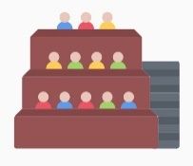
Some examples
Context and pedagogical objective: Gary is an English teacher in France. He wants to organize an intercultural exchange with another class in Europe so that his students practice English in real situations.
Pedagogical organization: with another teacher based in Italy, they plan four sessions of 1 hour during the semester, integrated into their regular English courses.
Before the first session, students can introduce themselves on an asynchronous platform and chose their peer. For each session, French and Italian groups plan activities and prepare conversational materials in turns .
During the four sessions, they interact with each other (2 to 2) by videoconference. After the sessions, each class debriefs together.
Technical and space organization: In the classroom, Gary will need to organize groups of two students clearly separated from one another. They bring and use their own devices (which they already know), provided that they enable audio and video.
Gary and the Italian teacher will have to secure the university connection and bandwidth, for example by contacting in advance the technical service.
Example 1
Context and pedagogical objective: Jil is an assistant professor in an English university. She has to teach a course to a very large group of students, which logistical and sanitary conditions do not allow to fully gather in person.
Pedagogical organization: the university will provide Jil with a videoconference setting for part of the students to attend at distance. The teacher will have to address both the remote and the face-to-face group.
Technical and space organization: The teacher will have to be careful to be visible, audible and intelligible to both audiences. She will also need to monitor communication channels to take into account questions or alerts from remote people. A student in the classroom will help her as a technical assistant.
Example 2
Example 3
Context and pedagogical objective: Students want to take a degree but cannot do so in person: they work full time, have a disability, are changing careers, are young parents, etc. The university will therefore give them the opportunity to take distance learning courses, mixed with face-to-face courses.
Pedagogical organization: Different possibilities are available to include these students with special needs. The university can offer students the choice of participating in face-to-face synchronous class sessions in-person (in a classroom) or participating in face-to-face class sessions via videoconference.
Technical and space organization: Class meetings recordings and materials should be available so that students can access them online or in-person, during or after class sessions. All students, regardless of their constraints should be able to achieve the same learning objectives.
Attribution: PENSA project (https://pensa.univ-amu.fr/) and Caroline Vincent, Marco Cappellini, Christine Appel and Christelle Combe

